Slide 1
Downtown Morgan Hill
Property Owner Meeting
September 19, 2022

Slide 2
Welcome
&
Introductions

Slide 3
Downtown New Businesses
Alara Cellars
Sushi Confidential
Palmerino’s Italian Market & Deli
Depot Street Pizza
Urbn Ranch
Cigarland
Bike Therapy (Specialized Store)
bLoom Lashes
VOICES Charter School @ CCC
Giorgio’s Italian Grill & Pizzeria – mid October
MOHI Farms – mid October

Slide 4
Downtown Projects
The Lumberyard
  49 Residential Units & 3,000 SF Commercial Space
EDES Art Gallery (Groundbreaking 9/22)
Hotel MOHI (Addendum submitted)
Depot Ave Realignment (expected completion Nov 1)
E. Dunne Ave Detour for Hale Ave Extension (ends 9/26)
Outdoor Dining Program
  Semi-permanent Parklets
  Sidewalk Café
  Code Enforcement

Slide 5
Events
Farmer’s Market (on-going)
Sidewalk Saturdays (through November)
Upcoming
Morgan Hill Chamber Car Show
  Saturday, September 24, 2022
  Monterey Rd reduced to one lane (Main to 4th)
Safe Trick or Treat
Holiday Light Parade
Mushroom Mardi Gras
  City re-evaluating future Downtown events
  Increasing need for safety & security measures
  Impacts to downtown cleanliness

Slide 6
Traffic, Parking & Safety
Downtown Lane Reduction
November Ballot: Measure B
  Citizens’ initiative amending the General Plan to require voter approval of any future Monterey Road lane reduction
Parking Management Plan
Short Term Parking (20 min)
  Support restaurants pick-up/delivery services
  Support all businesses with drop-off & pick-up
  Designated motorcycle parking
  Implementation requires enforcement
Cadet Program
  Wed – Sat, 5-10pm
  April through October
  Specific route/touchpoints

Slide 7
Property Based Improvement District (PBID)

Slide 8
PBID
Previous City Council Action
March 2, 2022, the City Council approved and authorized the City Manager to execute and administer a consulting agreement with Civitas Advisors to explore the formation of a Property Based Improvement District (PBID) in Downtown; and direct the City Manager to sign the PBID petition indicating the City’s support of the PBID formation.
This action is consistent with:
2017 Economic Blueprint - Action #21
2021 Covid-19 Business Recovery Plan

Slide 9
What is a PBID?
Special benefit assessment district that provides maintenance, public safety, beautification, and economic development programs above and beyond the City’s basic level of services.
City Council can establish a PBID after the owners of the district have indicated their support (or lack of opposition) for the PBID via petition, ballot or protest proceeding.
Property assessments are determined by an Engineer’s Report that is included in the Management District Plan.
City contracts with a nonprofit organization (normally owner’s association) to administer/provide services and improvements.
Nonprofit prepares an Annual Report which is used by the City as a basis for decision making and accountability.

Slide 10
Morgan Hill PBID History
A Downtown PBID was established in 2006 and ended in 2013
PBID supported many efforts, including:
In 2013 the City Council terminated the PBID management agreement due to a lapse in the tax-exempt corporation status.
$106,000 of previous MHDPBID Funds remain available
trash and recycle bins | marketing materials | banners | events
speaker system | flower baskets | flags | benches

Slide 11
MHPBID Purpose
To provide improvements, maintenance, and activities which constitute and convey a special benefit to assessed parcels.
Proposed Management District Plan:
Clean and Safe programs – 60%
Capital Improvements and Art Installations – 15%
Marketing and Special Events – 10%
Administration – 10%
Contingency/Reserve – 5%

Slide 12
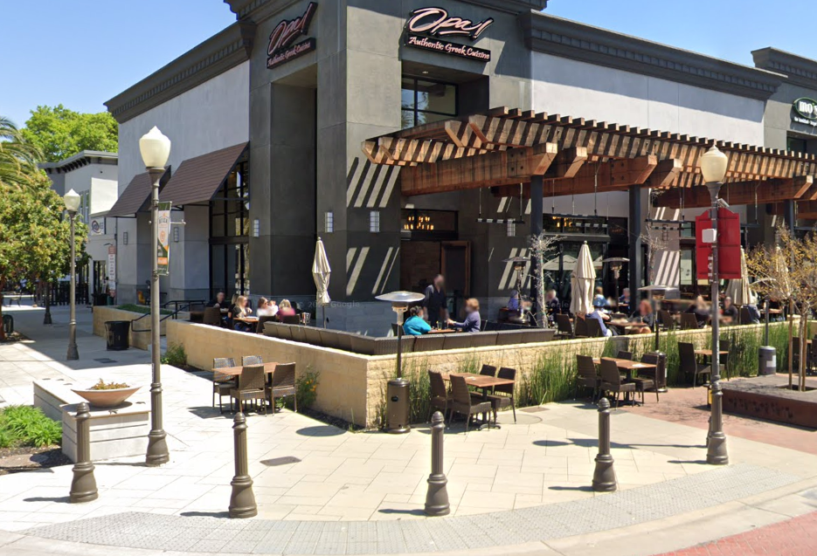
Examples of MHPBID Programming
Improving security – Security Cameras/Cadets
Adding lighting
Improving sidewalk cleaning
Improving landscape maintenance
Maintaining tree twinkle lighting
Decluttering sidewalks
Directional/Wayfinding signage
Holiday Decorations
Art Installations
Destination Marketing
New Events/Programming

Slide 13
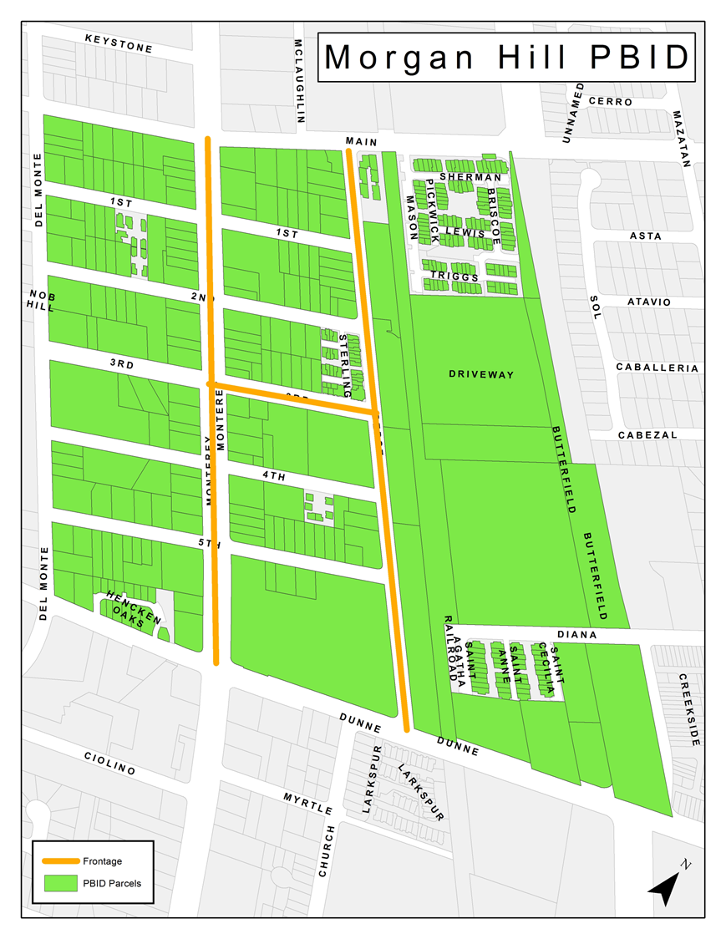
Proposed MHPBID Boundary

Slide 14
Proposed MHPBID Assessments
Cost to property owners is weighted based on size, location of property and direct benefit from services.
Parcel type | Square Footage Assessment rate (sq. ft.) | Linear Frontage Assessment rate (ln. ft.)
Commercial | $0.10 | $5.00
Non-profit | $0.04 | $2.00
Initial formation is for a 5-year period.
Multi- family, single-family and vacant parcels are not included in the assessment.
Assessments don’t begin until 2024.

Slide 15
Proposed MHPBID Assessments

Slide 16
MHPBID Formation Requirements
Step One:
MHPBID formation requires submittal of petitions from property owners representing more than 50% of the total assessment.
Step Two:
The “Right to Vote on Taxes Act” (also known as Prop 218) requires a ballot vote in which more than 50% of the ballots received, weighted by assessment, be in support of the MHPBID formation.

Slide 17
PBID Formation Assumptions
City will provide seed money to fund PBID formation.
City to get reimbursed over time once PBID is formed.
PBID can help cover growing needs of Downtown —sharing cost with other property owners.
New non-profit will be formed to manage PBID.
City to withhold petition and ballot support until majority of private sector petitions are secured.
New PBID group to direct spending from previous PBID assessments ($106,000).

Slide 18
PBID Formation Next Steps
Today – City Staff
  Signed Petition Gathering Phase
September 28, 2002 – City Council
  Resolution of Intention
  Resolution authorizing City Manager to sign ballot
September 29, 2022 – City Staff
  Mail Ballots
  Notice Public Hearing
November 16, 2022 – City Council
  Public Hearing
  Resolution of Formation
January 2024 – County Assessor's Office
  Assessment collection begins

Slide 19
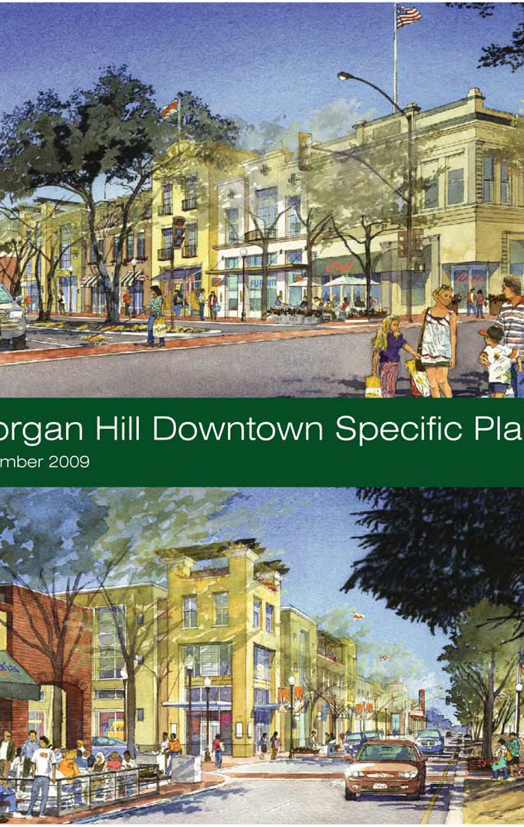
Vision Statement
“Strengthening Downtown as the gathering place, a connecting force, the social and activity heart of Morgan Hill, is the overriding aspiration of this Plan – a place where residents from all segments of the community can live, work, meet, shop, dine and participate in public celebrations, and share in the richness of Morgan Hill’s community life. It will be a place like nowhere else – a place with its own scale, character and uses.”

Slide 20
Questions

